Slide 1

CSS --
Cascading Style Sheet
Prepared by: Web Team

Slide 2
CSS Introduction
What is CSS?
CSS stands for Cascading Style Sheets
Styles define how to display HTML elements
Styles were added to HTML 4.0 to solve a problem
External Style Sheets can save a lot of work
External Style Sheets are stored in CSS files
CSS Saves a Lot of Work!
CSS defines HOW HTML elements are to be displayed.
Styles are normally saved in external .css files. External style sheets enable you to change the appearance and layout of all the pages in a Web site, just by editing one single file!

Slide 3
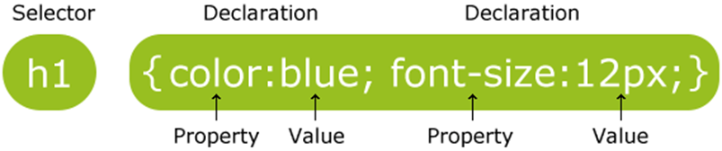
CSS Syntax
CSS Syntax
The selector is normally the HTML element you want to style.
Each declaration consists of a property and a value.
The property is the style attribute you want to change. Each property has a value.

Slide 4
CSS Syntax (cont.)
CSS Example
A CSS declaration always ends with a semicolon, and declaration groups are surrounded by curly brackets:
p {color:red;text-align:center;}
To make the CSS more readable, you can put one declaration on each line, like this:
p {
color:red;
text-align:center;
}

Slide 5
CSS Syntax (cont.)
CSS Comments
Comments are used to explain your code, and may help you when you edit the source code at a later date. Comments are ignored by browsers.
A CSS comment begins with "/*", and ends with "*/", like this:
/*This is a comment*/
p {
text-align:center;
/*This is another comment*/
color:black;
font-family:arial;
}

Slide 6
CSS Id & Class
The id and class Selectors
In addition to setting a style for a HTML element, CSS allows you to specify your own selectors called "id" and "class".
The id Selector
The id selector is used to specify a style for a single, unique element.
The id selector uses the id attribute of the HTML element, and is defined with a "#".
The style rule below will be applied to the element with id="para1":

Slide 7
CSS Id & Class (cont.)
Example
#para1 {
text-align:center;
color:red;
}
Note: Do NOT start an ID name with a number!
The class Selector
The class selector is used to specify a style for a group of elements. Unlike the id selector, the class selector is most often used on several elements.
This allows you to set a particular style for many HTML elements with the same class.

Slide 8
CSS Id & Class (cont.)
The class Selector
The class selector uses the HTML class attribute, and is defined with a "."
In the example below, all HTML elements with class="center" will be center-aligned:
Example
.center {text-align:center;}
You can also specify that only specific HTML elements should be affected by a class.
In the example below, all p elements with class="center" will be center-aligned:
Example p.center {text-align:center;}
Note: Do NOT start a class name with a number!

Slide 9
CSS Selectors
In CSS, selectors are patterns used to select the element(s) you want to style. There are my selector patterns in CSS.
* Selector : selects all the elements
Syntax:
* {
css declaration;
}
Element : select all the elements
Syntax: element {
css declaration;
}
Example:
* {
background-color : yellow;
}
Example: p {
background-color : yellow;
}

Slide 10
CSS Selectors (cont.)
Grouping Element : is used to minimize the code when there are elements with the same style. You have to separate each selector with a comma.
Syntax :
element, element {
css declaration
}
Nesting Selectors : It is possible to apply a style for a selector within a selector. There are 2 ways to apply nesting selector.
Separate each other with a space: element element
Stand next to each other: element.class or element#id
Example:
h1, h2 {
background-color : yellow;
}

Slide 11
CSS Selectors (cont.)
element element (space = nested)
Example:
div h2 {
background-color : yellow; }
element.class or element#id (without space = the same level)
Example:
div.red {
background-color : red; }

Slide 12
CSS Attribute Selectors
The [attribute] selector is used to select elements with the specified attribute.
Syntax: [attribute] {
css declarations;
}
CSS [attribute] Selector :
Example: a[target] {
background-color : yellow;
}

Slide 13
CSS Attribute Selectors (cont.)
CSS [attribute=“value”] Selector : Selector is used to select elements with a specified attribute and value.
Example: a[target=“_blank”] {
background-color : yellow;
}
CSS [attribute~=“value”] Selector : selector is used to select elements with an attribute value containing a specified word
Example: [title~=“flower”] {
border : 5px solid yellow;
}
<img src=”images/home.jpg” title=”my flower is red”/> *Case Sensitive

Slide 14
CSS Attribute Selectors (cont.)
CSS [attribute|=“value”] Selector : selector is used to select elements with the specified attribute starting with the specified value.
Note: The value has to be a whole word, either alone, like class="top", or followed by a hyphen( - ), like class="top-text"! *First in hyphen word
Example: [class|=“top”] {
background : yellow;
}
CSS [attribute^=“value”] Selector : selector is used to select elements whose attribute value begins with a specified value.
Note: The value does not have to be a whole word! *First character set in word
Example: [class^=“top”] { background : yellow; }

Slide 15
CSS Attribute Selectors (cont.)
CSS [attribute$=“value”] Selector : selector is used to select elements whose attribute value ends with a specified value.
Note: The value does not have to be a whole word! *last character set in word
Example: [class$=“top”] {
background : yellow;
}

Slide 16
CSS How to
When a browser reads a style sheet, it will format the document according to it.
Three Ways to Insert CSS
There are three ways of inserting a style sheet:
External style sheet
Internal style sheet
Inline style

Slide 17
CSS How to (cont.)
External Style Sheet
An external style sheet is ideal when the style is applied to many pages. With an external style sheet, you can change the look of an entire Web site by changing one file. Each page must link to the style sheet using the <link> tag.
The <link> tag goes inside the head section:
<head>
<link rel="stylesheet" href="mystyle.css">
</head>

Slide 18
CSS How to (cont.)
An external style sheet can be written in any text editor. The file should not contain any html tags. Your style sheet must be saved with a .css extension.
An example of a style sheet file is shown below:
hr {color:sienna;}
p {margin-left:20px;}
body {background-image:url("images/background.gif");}
Note: Do not add a space between the property value and the unit (such as margin-left:20 px). The correct way is: margin-left:20px.

Slide 19
CSS How to (cont.)
Internal Style Sheet
An internal style sheet may be used if one single HTML page has a unique style.
The internal style is defined inside the <style> element, inside the head section.
The <style> element goes inside the head section:
<style>
* {
background-color: yellowgreen;
}
</style>

Slide 20
CSS How to (cont.)
Inline Styles
An inline style loses many of the advantages of style sheets by mixing content with presentation. Use this method sparingly!
To use inline styles you use the style attribute in the relevant tag. The style attribute can contain any CSS property. The example shows how to change the color and the left margin of a paragraph:
<p style="color:sienna;margin-left:20px;">This is a paragraph.</p>

Slide 21
CSS How to (cont.)
Multiple Style Sheets
If some properties have been set for the same selector in different style sheets, the values will be inherited from the more specific style sheet.
For example, an external style sheet has these properties for the h3 selector:
h3 {
color:red;
text-align:left;
font-size:8pt;
}

Slide 22
CSS How to (cont.)
And an internal style sheet has these properties for the h3 selector:
h3{
text-align:right;
font-size:20pt;
}
If the page with the internal style sheet also links to the external style sheet the properties for h3 will be:
color:red;
text-align:right;
font-size:20pt;
The color is inherited from the external style sheet and the text-alignment and the font-size is replaced by the internal style sheet.

Slide 23
CSS How to (cont.)
Multiple Styles Will Cascade into One
Styles can be specified:
inside an HTML element
inside the head section of an HTML page
in an external CSS file
Tip: Even multiple external style sheets can be referenced inside a single HTML document.

Slide 24
CSS How to (cont.)
Cascading order
What style will be used when there is more than one style specified for an HTML element?
Generally speaking, we can say that all the styles will "cascade" into a new "virtual" stylesheet by the following rules, where number 4 has the highest priority:
1.Browser default
2.External style sheet
3.Internal style sheet (in the head section)
4.Inline style (inside an HTML element)

Slide 25
CSS How to (cont.)
Cascading order
So, an inline style (inside an HTML element) has the highest priority, which means that it will override a style defined inside the <head> tag, or in an external style sheet, or in a browser (a default value).
Note: If the link to the external style sheet is placed after the internal style sheet in HTML <head>, the external style sheet will override the internal style sheet!

Slide 26
CSS Background
CSS background properties are used to define the background effects of an element.
CSS properties used for background effects:
background-color
background-image
background-repeat
background-attachment
background-position
background-size
background-origin
Notes:
You will also learn about the following new CSS3 properties:
background-size
background-origin
background-clip

Slide 27
CSS Background (cont.)
Background Color
The background-color property specifies the background color of an element.
The background color of a page is defined in the body selector:
Example:
body {background-color:#b0c4de;}
With CSS, a color is most often specified by:
a HEX value - like "#ff0000"
an RGB value - like "rgb(255,0,0)“ and “rbga(0,255,255,0.4)”
a color name - like "red"

Slide 28
CSS Background (cont.)
In the example below, the h1, p, and div elements have different background colors:
Example
h1 {background-color:#6495ed;}
p {background-color:#e0ffff;}
div {background-color:#b0c4de;}
Background Image
The background-image property specifies an image to use as the background of an element.
By default, the image is repeated so it covers the entire element.
Notes:
CSS3 Multiple Backgrounds
CSS3 allows you to add multiple background images for an element, through the background-image property.
The different background images are separated by commas, and the images are stacked on top of each other, where the first image is closest to the viewer.
The following example has two background images, the first image is a flower (aligned to the bottom and right) and the second image is a paper background (aligned to the top-left corner):
#example1 {
background-image: url(img_flwr.gif), url(paper.gif);
background-position: right bottom, left top;
background-repeat: no-repeat, repeat;
}

Slide 29
CSS Background (cont.)
The background image for a page can be set like this:
Example
body {background-image:url("paper.gif");}
Below is an example of a bad combination of text and background image. The text is almost not readable:
Example
body {background-image:url("bgdesert.jpg");}
Notes:
Multiple background images can be specified using either the individual background properties (as above) or the background shorthand property.
The following example uses the background shorthand property (same result as example above):

Slide 30
CSS Background (cont.)
Background Image - Repeat Horizontally or Vertically
By default, the background-image property repeats an image both horizontally and vertically.
Some images should be repeated only horizontally or vertically, or they will look strange, like this:
Example
body {
background-image:url("gradient2.png");
}

Slide 31
CSS Background (cont.)
Background Image - Repeat Horizontally or Vertically
If the image is repeated only horizontally (repeat-x), the background will look better:
Example
body {
background-image:url("gradient2.png");
background-repeat:repeat-x;
}

Slide 32
CSS Background (cont.)
Background Image - Set position and no-repeat
Note: When using a background image, use an image that does not disturb the text.
Showing the image only once is specified by the background-repeat property:
Example
body {
background-image:url("img_tree.png");
background-repeat:no-repeat;
}

Slide 33
CSS Background (cont.)
In the example above, the background image is shown in the same place as the text. We want to change the position of the image, so that it does not disturb the text too much.
The position of the image is specified by the background-position property:
Example
body {
background-image:url("img_tree.png");
background-repeat:no-repeat;
background-position:right top;
}

Slide 34
CSS Background (cont.)
Background - Shorthand property
As you can see from the examples above, there are many properties to consider when dealing with backgrounds.
To shorten the code, it is also possible to specify all the properties in one single property. This is called a shorthand property.
The shorthand property for background is simply "background":
Example
body {background:#ffffff url("img_tree.png") no-repeat right top;}
When using the shorthand property the order of the property values is:
background-color
background-image
background-repeat

Slide 35
CSS Background (cont.)
Background - Shorthand property
background-attachment
background-position
It does not matter if one of the property values is missing, as long as the ones that are present are in this order.
Notes:
The two other possible values for background-size are contain and cover.
~ The contain keyword scales the background image to be as large as possible (but both its width and its height must fit inside the content area). As such, depending on the proportions of the background image and the background positioning area, there may be some areas of the background which are not covered by the background image.
~ The cover keyword scales the background image so that the content area is completely covered by the background image (both its width and height are equal to or exceed the content area). As such, some parts of the background image may not be visible in the background positioning area.
The following example illustrates the use of contain and cover:

Slide 36
CSS Background (cont.)
CSS3 Multiple Background
CSS3 allows you to add multiple background images for an element, through the background-image property
The different background images are separated by commas, and the images are stacked on top of each other, where the first image is closest to the viewer.
Example:
The example above has two background images, the 1st image is a flower (aligned to the bottom and right) & the 2nd image is paper background (aligned to the top-left corner)
#example1 {
background-image: url(img_flwr.gif), url(paper.gif);
background-position: right bottom, left top;
background-repeat: no-repeat, repeat; }

Slide 37
CSS Background (cont.)
CSS3 Multiple Background
Multiple background images can be specified using either the individual background properties (as above) or the background shorthand property.
Example:
#example1 {
background: url(img_flwr.gif) right bottom no-repeat, url(paper.gif) left top repeat;
}

Slide 38
CSS Background (cont.)
CSS3 Background Size
The CSS3 background-size property allows you to specify the size of background images.
Before CSS3, the size of a background image was the actual size of the image. CSS3 allows us to re-use background images in different contexts.
The size can be specified in lengths, percentages, or by using one of the two keywords: contain or cover.

Slide 39
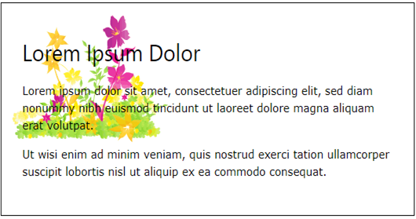
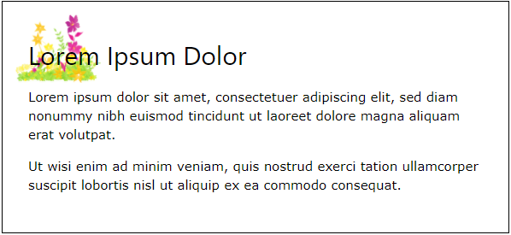
CSS Background (cont.)
The following example resizes a background image to much smaller than the original image (using pixels):
Original background image:
Resized background image:

Slide 40
CSS Background (cont.)
Example:
The two other possible values for background-size are contain and cover.
The contain keyword: scales the background image to be as large as possible (but both its width and its height must fit inside the content area). As such, depending on the proportions of the background image and the background positioning area, there may be some areas of the background which are not covered by the background image.
#div1 {
background: url(img_flower.jpg);
background-size: 100px 80px;
background-repeat: no-repeat;
}

Slide 41
CSS Background (cont.)
The cover keyword: scales the background image so that the content area is completely covered by the background image (both its width and height are equal to or exceed the content area). As such, some parts of the background image may not be visible in the background positioning area.

Slide 42
CSS Background (cont.)
Example: This example illustrates the use of contain and cover.
#div1 {
background: url(img_flower.jpg);
background-size: contain;
background-repeat: no-repeat;
}
#div2 {
background: url(img_flower.jpg);
background-size: cover;
background-repeat: no-repeat;
}

Slide 43
CSS Background (cont.)
Define Sizes of Multiple Background Images
The background-size property also accepts multiple values for background size (using a comma-separated list), when working with multiple backgrounds.
The following example has three background images specified, with different background-size value for each image:
#example1 {
background: url(img_flwr.gif) left top no-repeat, url(img_flwr.gif) right bottom no-repeat, url(paper.gif) left top repeat;
background-size: 50px, 130px, auto;
}

Slide 44
CSS Background (cont.)
Full Size Background Image
Now we want to have a background image on a website that covers the entire browser window at all times.
The requirements are as follows:
Fill the entire page with the image (no white space)
Scale image as needed
Center image on page
Do not cause scrollbars

Slide 45
CSS Background (cont.)
The following example shows how to do it; Use the html element (the html element is always at least the height of the browser window). Then set a fixed and centered background on it. Then adjust its size with the background-size property:
Example:
html {
background: url(img_flower.jpg) no-repeat center fixed;
background-size: cover;
}

Slide 46
CSS Background (cont.)
CSS3 Background-origin Property
The CSS3 background-origin property specifies where the background image is positioned.
The property takes three different values:
border-box - the background image starts from the upper left corner of the border
padding-box - (default) the background image starts from the upper left corner of the padding edge
content-box - the background image starts from the upper left corner of the content
Note: This property has no effect if background-attachment is "fixed".

Slide 47
CSS Background (cont.)
Example:
#example1 {
border: 10px solid black;
padding: 35px;
background: url(img_flwr.gif);
background-repeat: no-repeat;
background-origin: content-box;
}

Slide 48
CSS Text
Text Color
The color property is used to set the color of the text.
With CSS, a color is most often specified by:
a HEX value - like "#ff0000"
an RGB value - like "rgb(255,0,0)"
a color name - like "red"
The default color for a page is defined in the body selector.
Example
body {color:blue;}
h1 {color:#00ff00;}
h2 {color:rgb(255,0,0);}
Notes:
Note: For W3C compliant CSS: If you define the color property, you must also define the background-color property.

Slide 49
CSS Text (cont.)
Text Alignment
The text-align property is used to set the horizontal alignment of a text.
Text can be centered, or aligned to the left or right, or justified.
When text-align is set to "justify", each line is stretched so that every line has equal width, and the left and right margins are straight (like in magazines and newspapers).
Example
h1 {text-align:center;}
p.date {text-align:right;}
p.main {text-align:justify;}

Slide 50
CSS Text (cont.)
Text Decoration
The text-decoration property is used to set or remove decorations from text.
The text-decoration property is mostly used to remove underlines from links for design purposes:
Example: a {text-decoration:none;}
It can also be used to decorate text:
Example:
h1 {text-decoration:overline;}
h2 {text-decoration:line-through;}
h3 {text-decoration:underline;}
Notes:
Note: It is not recommended to underline text that is not a link, as this often confuses users.

Slide 51
CSS Text (cont.)
Text Transformation
The text-transform property is used to specify uppercase and lowercase letters in a text.
It can be used to turn everything into uppercase or lowercase letters, or capitalize the first letter of each word.
Example
p.uppercase {text-transform:uppercase;}
p.lowercase {text-transform:lowercase;}
p.capitalize {text-transform:capitalize;}

Slide 52
CSS Text (cont.)
Text Indentation
The text-indent property is used to specify the indentation of the first line of a text.
Example: p {text-indent:50px;}
Letter Spacing
The letter-spacing property is used to specify the space between the characters in a text.
Example:
h1 { letter-spacing: 3px; }
h1 { letter-spacing: -3px; }

Slide 53
CSS Text (cont.)
Line Height
The line-height property is used to specify the space between lines.
Example:
p.small { line-height: 0.8; }
Text Direction
The direction property is used to change the text direction.
Example:
p { direction: rtl; } ( rtl = right to left )

Slide 54
CSS Text (cont.)
Word Spacing
The word-spacing property is used to specify the space between the words in a text.
Example:
h1 { word-spacing: 10px; }
Text Shadow
The text-shadow property adds shadows to text.
Example: h1 { text-shadow: 3px 2px red; }

Slide 55
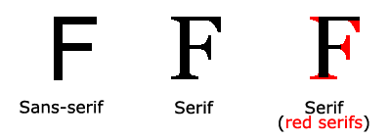
CSS Font
CSS font properties define the font family, boldness, size, and the style of a text.
Difference Between Serif and Sans-serif Fonts

Slide 56
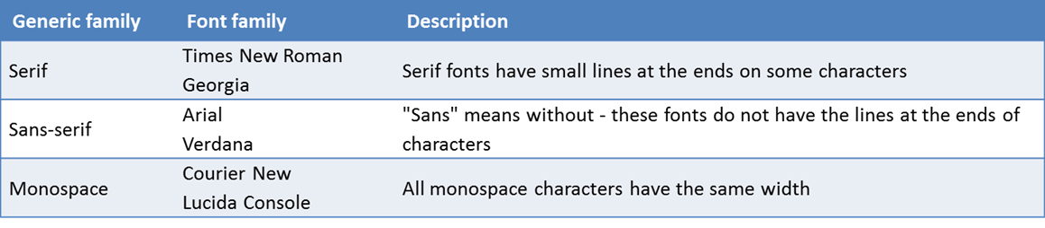
CSS Font (cont.)
CSS Font Families
In CSS, there are two types of font family names:
generic family - a group of font families with a similar look (like "Serif" or "Monospace")
font family - a specific font family (like "Times New Roman" or "Arial")
Note: On computer screens, sans-serif fonts are considered easier to read than serif fonts.

Slide 57
CSS Font (cont.)
Font Family
The font family of a text is set with the font-family property.
The font-family property should hold several font names as a "fallback" system. If the browser does not support the first font, it tries the next font.
Start with the font you want, and end with a generic family, to let the browser pick a similar font in the generic family, if no other fonts are available.
Note: If the name of a font family is more than one word, it must be in quotation marks, like: "Times New Roman".
More than one font family is specified in a comma-separated list:
Example: p { font-family:"Times New Roman", Times, serif;}

Slide 58
CSS Font (cont.)
Font Family – Download Embed
In case, We want to use to support all browsers; we have to link or download that fonts to embed with your project. Example: Google fonts usage : fonts.google.com ~search name of fonts you love ~select that fonts to get link : <link href="https://fonts.googleapis.com/css?family=Roboto&display=swap" rel="stylesheet"> Usage: font-family: 'Roboto', sans-serif;

Slide 59
CSS Font (cont.)
Font Family – Download Embed 1. Download font - @font-face rule ~download font file type: fontname.ttf or fontname.wotf, ………. ~copy that file to your project Usage: @font-face { font-family: "Fasthand-Regular"; src: url("../fonts/Fasthand-Regular.ttf"); } h1{ font-family: “Fasthand-Regular”; }

Slide 60
CSS Font (cont.)
Icon 1. Icon: Small pictorial symbol used in a graphical user interface (GUI) or in web documents to identify a file, folder, program, or device (such as drive, modem, printer). 2. There are a lot of website that publish icon with different ui such as fontawesome, icon8, flaticon, googleicon………. 3. All of icons above is required to link to css file or download it. ~Icon8 follow the instruction

Slide 61
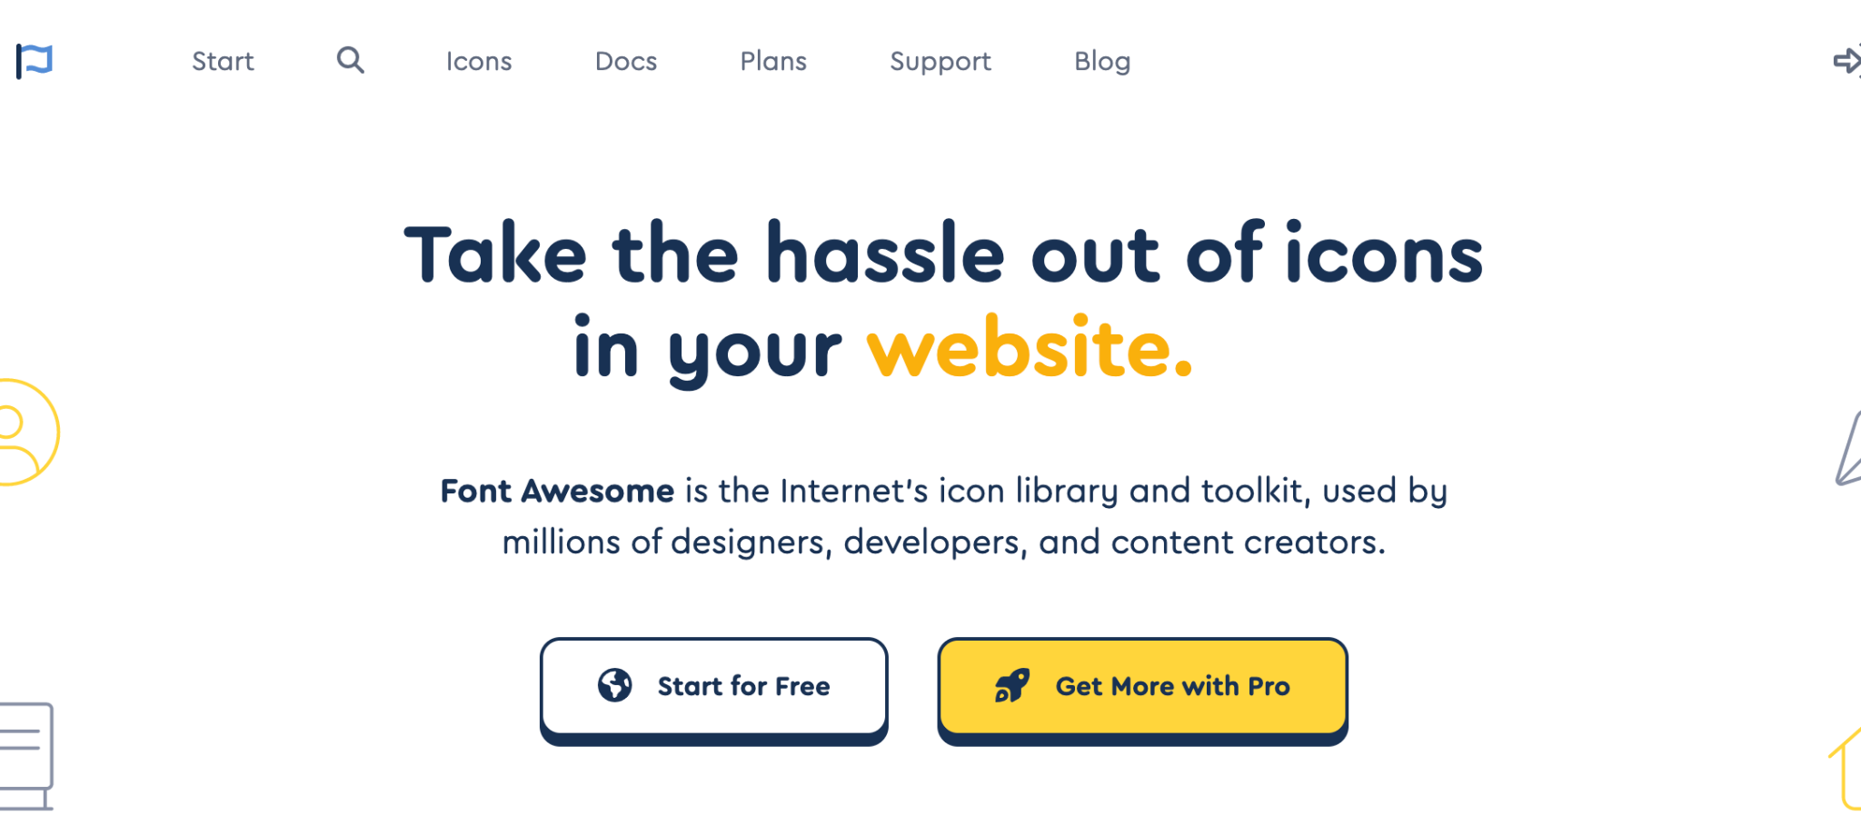
CSS Font (cont.)
Icon
How to use fontawesome ?
Click Start for free

Slide 62

CSS Font (cont.)
fontawesome
Fill email then send kit code

Slide 63
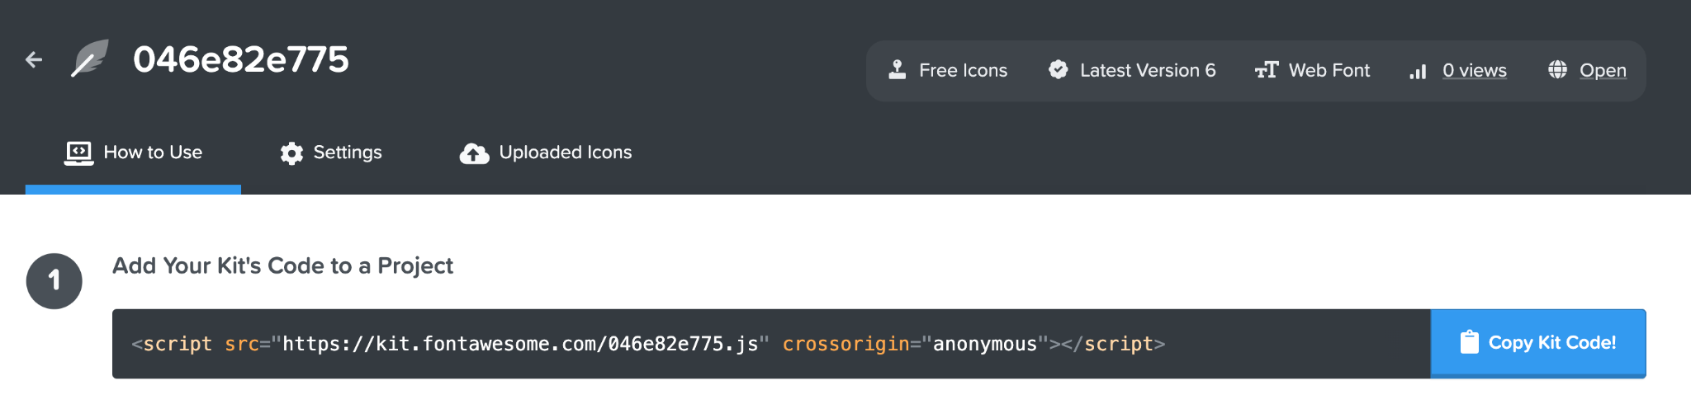
CSS Font (cont.)
fontawesome
Copy kit code and use it on your project

Slide 64
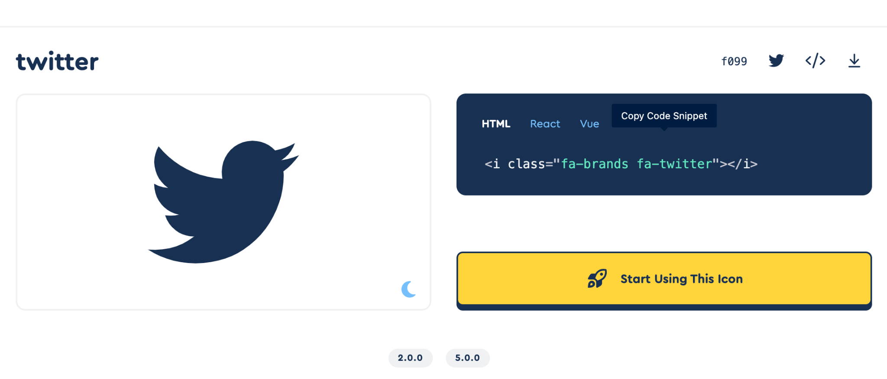
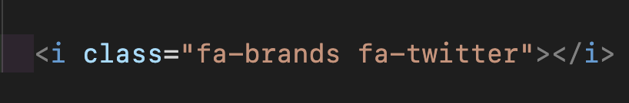
CSS Font (cont.)
fontawesome

Slide 65
CSS Font (cont.)
Font Size
The font-size property sets the size of the text.
Being able to manage the text size is important in web design. However, you should not use font size adjustments to make paragraphs look like headings, or headings look like paragraphs.
Always use the proper HTML tags, like <h1> - <h6> for headings and <p> for paragraphs.

Slide 66
CSS Font (cont.)
Example
h1 {font-size:2.5em;} /* 40px/16=2.5em */
h2 {font-size:1.875em;} /* 30px/16=1.875em */
p {font-size:0.875em;} /* 14px/16=0.875em */
In the example above, the text size in em is the same as the previous example in pixels. However, with the em size, it is possible to adjust the text size in all browsers.
Unfortunately, there is still a problem with older versions of IE. The text becomes larger than it should when made larger, and smaller than it should when made smaller.

Slide 67
CSS Font (cont.)
Use a Combination of Percent and Em
The solution that works in all browsers, is to set a default font-size in percent for the <body> element:
Example
body {font-size:100%;}
h1 {font-size:2.5em;}
h2 {font-size:1.875em;}
p {font-size:0.875em;}
Our code now works great! It shows the same text size in all browsers, and allows all browsers to zoom or resize the text!

Slide 68
CSS Link
Links can be styled in different ways.
Styling Links
Links can be styled with any CSS property (e.g. color, font-family, background, etc.).
In addition, links can be styled differently depending on what state they are in.
The four links states are:
a:link - a normal, unvisited link
a:visited - a link the user has visited
a:hover - a link when the user mouses over it
a:active - a link the moment it is clicked

Slide 69
CSS Link (cont.)
Example
a:link {color:#FF0000;} /* unvisited link */
a:visited {color:#00FF00;} /* visited link */
a:hover {color:#FF00FF;} /* mouse over link */
a:active {color:#0000FF;} /* selected link */
When setting the style for several link states, there are some order rules:
a:hover MUST come after a:link and a:visited
a:active MUST come after a:hover
Common Link Styles
In the example above the link changes color depending on what state it is in.

Slide 70
CSS Link (cont.)
Text Decoration
The text-decoration property is mostly used to remove underlines from links:
Example
a:link {text-decoration:none;}
a:visited {text-decoration:none;}
a:hover {text-decoration:underline;}
a:active {text-decoration:underline;}

Slide 71
CSS Link (cont.)
Background Color
The background-color property specifies the background color for links:
Example
a:link {background-color:#B2FF99;}
a:visited {background-color:#FFFF85;}
a:hover {background-color:#FF704D;}
a:active {background-color:#FF704D;}

Slide 72
CSS List
The CSS list properties allow you to:
Set different list item markers for ordered lists
Set different list item markers for unordered lists
Set an image as the list item marker
List
In HTML, there are two types of lists:
unordered lists - the list items are marked with bullets
ordered lists - the list items are marked with numbers or letters
With CSS, lists can be styled further, and images can be used as the list item marker.

Slide 73
CSS List (cont.)
Different List Item Markers
The type of list item marker is specified with the list-style-type property:
Example
ul.a {list-style-type: circle;}
ul.b {list-style-type: square;}
ol.c {list-style-type: upper-roman;}
ol.d {list-style-type: lower-alpha;}
Some of the values are for unordered lists, and some for ordered lists.

Slide 74
CSS List (cont.)
An Image as The List Item Marker
To specify an image as the list item marker, use the list-style-image property:
Example
ul {
list-style-image: url('sqpurple.gif');
}
The example above does not display equally in all browsers. IE and Opera will display the image-marker a little bit higher than Firefox, Chrome, and Safari.
If you want the image-marker to be placed equally in all browsers, a crossbrowser solution is explained below.

Slide 75
CSS List (cont.)
Crossbrowser Solution
The following example displays the image-marker equally in all browsers:
Example
ul {
list-style-type: none;
padding: 0px;
margin: 0px; }
ul li {
background-image: url(sqpurple.gif);
background-repeat: no-repeat;
background-position: 0px 5px;
padding-left: 14px; }

Slide 76
CSS List (cont.)
Crossbrowser Solution
Example explained:
For ul:
Set the list-style-type to none to remove the list item marker
Set both padding and margin to 0px (for cross-browser compatibility)
For all li in ul:
Set the URL of the image, and show it only once (no-repeat)
Position the image where you want it (left 0px and down 5px)
Position the text in the list with padding-left

Slide 77
CSS List (cont.)
List - Shorthand property
It is also possible to specify all the list properties in one, single property. This is called a shorthand property.
The shorthand property used for lists, is the list-style property:
Example
ul { list-style: square url("sqpurple.gif"); }
When using the shorthand property, the order of the values are:
list-style-type
list-style-position (for a description, see the CSS properties table below)
list-style-image
It does not matter if one of the values above are missing, as long as the rest are in the specified order.

Slide 78
CSS Table
Table Borders
To specify table borders in CSS, use the border property.
The example below specifies a black border for table, th, and td elements:
Example
table, th, td { border: 1px solid black; }
Notice that the table in the example above has double borders. This is because both the table and the th/td elements have separate borders.
To display a single border for the table, use the border-collapse property.

Slide 79
CSS Table (cont.)
Collapse Borders
The border-collapse property sets whether the table borders are collapsed into a single border or separated:
Example
table { border-collapse:collapse; }
table, th, td { border: 1px solid black; }
Table Width and Height
Width and height of a table is defined by the width and height properties.
The example below sets the width of the table to 100%, and the height of the th elements to 50px:
Example
table { width:100%; } th { height:50px; }

Slide 80
CSS Table (cont.)
Table Text Alignment
The text in a table is aligned with the text-align and vertical-align properties.
The text-align property sets the horizontal alignment, like left, right, or center:
Example
td { text-align:right; }
The vertical-align property sets the vertical alignment, like top, bottom, or middle:
Example
td { height:50px; vertical-align:bottom; }

Slide 81
CSS Table (cont.)
Table Padding
To control the space between the border and content in a table, use the padding property on td and th elements:
Example
td { padding:15px; }
Table Color
The example below specifies the color of the borders, and the text and background color of th elements:
Example
table, td, th { border:1px solid green; }
th { background-color:green; color:white; }
Notes:
77

Slide 82
CSS Box Model
The CSS Box Model
All HTML elements can be considered as boxes. In CSS, the term "box model" is used when talking about design and layout.
The CSS box model is essentially a box that wraps around HTML elements, and it consists of: margins, borders, padding, and the actual content.
The box model allows us to place a border around elements and space elements in relation to other elements.

Slide 83
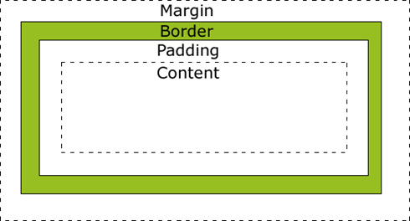
CSS Box Model (cont.)
Explanation of the different parts:
Margin - Clears an area around the border. The margin does not have a background color, it is completely transparent
Border - A border that goes around the padding and content. The border is inherited from the color property of the box

Slide 84
CSS Box Model (cont.)
Padding - Clears an area around the content. The padding is affected by the background color of the box
Content - The content of the box, where text and images appear
In order to set the width and height of an element correctly

Slide 85
CSS Box Model (cont.)
Width and Height of an Element
Important: When you set the width and height properties of an element with CSS, you just set the width and height of the content area. To calculate the full size of an element, you must also add the padding, borders and margins.
The total width of the element in the example below is 300px:
width:250px;
padding:10px;
border:5px solid gray;
Margin:10px;
Let's do the math:
250px (width)
+ 20px (left + right padding)
+ 10px (left + right border)
+ 20px (left + right margin) = 300px

Slide 86
CSS Box Model (cont.)
Assume that you had only 250px of space. Let's make an element with a total width of 250px:
Example
width:220px;
padding:10px;
border:5px solid gray;
Margin:0px;

Slide 87
CSS Box Model (cont.)
The total width of an element should be calculated like this:
Total element width = width + left padding + right padding + left border + right border + left margin + right margin
The total height of an element should be calculated like this:
Total element height = height + top padding + bottom padding + top border + bottom border + top margin + bottom margin

Slide 88
CSS Borders
CSS Border Properties
The CSS border properties allow you to specify the style and color of an element's border.
Border Style
The border-style property specifies what kind of border to display.
Note: None of the border properties will have ANY effect unless the border-style property is set!
border-style values:
none
dotted
dashed
solid
Double
Groove
Ridge
Inset
outset
Notes:
Finish Part1

Slide 89
CSS Borders (cont.)
Border Width
The border-width property is used to set the width of the border.
The width is set in pixels, or by using one of the three predefined values: thin, medium, or thick.
Note: The "border-width" property does not work if it is used alone. Use the "border-style" property to set the borders first.
Example
p.one {
border-style:solid;
border-width:5px;
}
p.two {
border-style:solid;
border-width:medium;
}

Slide 90
CSS Borders (cont.)
Border Color
The border-color property is used to set the color of the border.
You can also set the border color to "transparent".
Note: The "border-color" property does not work if it is used alone. Use the "border-style" property to set the borders first.
Example
p.one {
border-style:solid;
border-color:red;
}
p.two {
border-style:solid;
Border-color: #98bf21;
}

Slide 91
CSS Borders (cont.)
Border - Individual sides
In CSS it is possible to specify different borders for different sides:
Example
p {
border-top-style:dotted;
border-right-style:solid;
border-bottom-style:dotted;
border-left-style:solid;
}
The example above can also be set with a single property:
Example: border-style:dotted solid;

Slide 92
CSS Borders (cont.)
border-style: dotted solid;
top and bottom borders are dotted
right and left borders are solid
Border-style:dotted;
all four borders are dotted
The border-style property is used in the example above. However, it also works with border-width and border-color.

Slide 93
CSS Borders (cont.)
The border-style property can have from one to four values.
border-style: dotted solid double dashed;
top border is dotted
right border is solid
bottom border is double
left border is dashed
border-style: dotted solid double;
top border is dotted
right and left borders are solid
bottom border is double

Slide 94
CSS Borders (cont.)
Border - Shorthand property
As you can see from the examples above, there are many properties to consider when dealing with borders.
To shorten the code, it is also possible to specify all the individual border properties in one property. This is called a shorthand property.
The border property is a shorthand for the following individual border properties:
border-width
border-style (required)
border-color
Example
border:5px solid red;

Slide 95
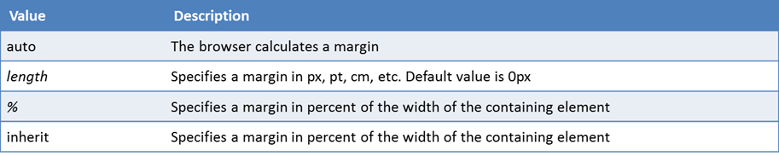
CSS Margin
The CSS margin properties define the space around elements.
Margin
The margin clears an area around an element (outside the border). The margin does not have a background color, and is completely transparent.
The top, right, bottom, and left margin can be changed independently using separate properties. A shorthand margin property can also be used, to change all margins at once.
Possible Values
Notes:
Note: It is also possible to use negative values, to overlap content.

Slide 96
CSS Margin (cont.)
Margin - Individual sides
In CSS, it is possible to specify different margins for different sides:
Example: margin-top:100px;
margin-bottom:100px;
margin-right:50px;
margin-left:50px;
Margin - Shorthand property
To shorten the code, it is possible to specify all the margin properties in one property. This is called a shorthand property.
The shorthand property for all the margin properties is "margin":
Example: margin:100px 50px;

Slide 97
CSS Margin (cont.)
The margin property can have from one to four values.
margin:25px 50px 75px 100px;
top margin is 25px
right margin is 50px
bottom margin is 75px
left margin is 100px
margin:25px 50px 75px;
top margin is 25px
right and left margins are 50px
bottom margin is 75px

Slide 98
CSS Margin (cont.)
The margin property can have from one to four values.
margin:25px 50px;
top and bottom margins are 25px
right and left margins are 50px
margin:25px;
all four margins are 25px

Slide 99
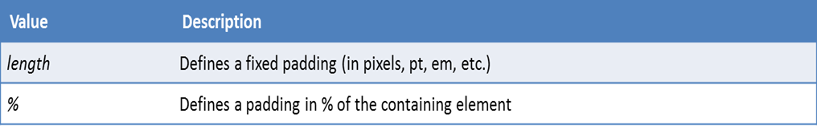
CSS Padding
The CSS padding properties define the space between the element border and the element content.
Padding
The padding clears an area around the content (inside the border) of an element. The padding is affected by the background color of the element.
The top, right, bottom, and left padding can be changed independently using separate properties. A shorthand padding property can also be used, to change all paddings at once.
Possible Values

Slide 100
CSS Padding (cont.)
Padding - Shorthand property
To shorten the code, it is possible to specify all the padding properties in one property. This is called a shorthand property.
The shorthand property for all the padding properties is "padding":
Example
padding:25px 50px;

Slide 101
CSS Padding (cont.)
The padding property can have from one to four values.
padding:25px 50px 75px 100px;
top padding is 25px
right padding is 50px
bottom padding is 75px
left padding is 100px
padding:25px 50px 75px;
top padding is 25px
right and left paddings are 50px
bottom padding is 75px

Slide 102
CSS Padding (cont.)
The padding property can have from one to four values.
padding:25px 50px;
top and bottom paddings are 25px
right and left paddings are 50px
padding:25px;
all four paddings are 25px

Slide 103
CSS Display
The display property specifies if/how an element is displayed, and the visibility property specifies if an element should be visible or hidden.
Hiding an Element - display:none or visibility:hidden
Hiding an element can be done by setting the display property to "none" or the visibility property to "hidden". However, notice that these two methods produce different results:
visibility:hidden hides an element, but it will still take up the same space as before. The element will be hidden, but still affect the layout.
Example
h1.hidden {visibility:hidden;}

Slide 104
CSS Display (cont.)
display:none hides an element, and it will not take up any space. The element will be hidden, and the page will be displayed as if the element is not there:
Example
h1.hidden {display:none;}

Slide 105
CSS Display (cont.)
CSS Display - Block and Inline Elements
A block element is an element that takes up the full width available, and has a line break before and after it.
Examples of block elements: <h1>, <p>, <div>
An inline element only takes up as much width as necessary, and does not force line breaks.
Examples of inline elements: <span>, <a>

Slide 106
CSS Display (cont.)
Changing How an Element is Displayed
Changing an inline element to a block element, or vice versa, can be useful for making the page look a specific way, and still follow web standards.
The following example displays list items as inline elements:
Example
li {display:inline;}
The following example displays span elements as block elements:
Example
span {display:block;}

Slide 107
CSS Display (cont.)
The display: inline-block value
Compared to display: inline, the major difference is that display: inline-block allows to set a width and height on the element.
Also, with display: inline-block, the top and bottom margins/paddings are respected, but with display: inline they are not.
Compared to display: block, the major difference is that display: inline-block does not add a line-break after the element, so the element can sit next to other elements.

Slide 108
CSS Display (cont.)
The display: inline-block usage
Use inline-block to create navigation links
One common use for display: inline-block is to create horizontal navigation links.
Use with Grid of Boxes
It has been possible for a long time to create a grid of boxes that fills the browser width and wraps nicely (when the browser is resized), by using the float property.

Slide 109
CSS Display (cont.)
The old way - using float (notice that we also need to specify a clear property for the element after the floating boxes):
Example: .floating-box {
float: left;
width: 150px;
height: 75px;
margin: 10px;
border: 3px solid #73AD21;
}
.after-box {
clear: left;
}

Slide 110
CSS Display (cont.)
The same effect can be achieved by using the inline-block value of the display property (notice that no clear is needed):
Example: .floating-box {
display: inline-block;
width: 150px;
height: 75px;
margin: 10px;
border: 3px solid #73AD21;
}

Slide 111
CSS Positioning
Positioning
The CSS positioning properties allow you to position an element. It can also place an element behind another, and specify what should happen when an element's content is too big.
Elements can be positioned using the top, bottom, left, and right properties. However, these properties will not work unless the position property is set first. They also work differently depending on the positioning method.
There are four different positioning methods.

Slide 112
CSS Positioning (cont.)
Static Positioning
HTML elements are positioned static by default. A static positioned element is always positioned according to the normal flow of the page.
Static positioned elements are not affected by the top, bottom, left, and right properties.
Fixed Positioning
An element with fixed position is positioned relative to the browser window.
It will not move even if the window is scrolled:

Slide 113
CSS Positioning (cont.)
Fixed Positioning
Example
p.pos_fixed {
position:fixed;
top:30px;
right:5px;
}
Fixed positioned elements are removed from the normal flow. The document and other elements behave like the fixed positioned element does not exist.
Fixed positioned elements can overlap other elements.

Slide 114
CSS Positioning (cont.)
Relative Positioning
A relative positioned element is positioned relative to its normal position.
Example
h2.pos_left {
position:relative;
left:-20px; }
h2.pos_right {
position:relative;
left:20px; }

Slide 115
CSS Positioning (cont.)
Relative Positioning
The content of relatively positioned elements can be moved and overlap other elements, but the reserved space for the element is still preserved in the normal flow.
Example
h2.pos_top{
position:relative;
top:-50px; }
Relatively positioned elements are often used as container blocks for absolutely positioned elements.

Slide 116
CSS Positioning (cont.)
Absolute Positioning
An absolute position element is positioned relative to the first parent element that has a position other than static. If no such element is found, the containing block is <html>:
Example
h2 {
position:absolute;
left:100px;
top:150px;
}
Absolutely positioned elements are removed from the normal flow. The document and other elements behave like the absolutely positioned element does not exist.
Absolutely positioned elements can overlap other elements.

Slide 117
CSS Positioning (cont.)
Overlapping Elements (z-index)
When elements are positioned outside the normal flow, they can overlap other elements.
The z-index property specifies the stack order of an element (which element should be placed in front of, or behind, the others).
An element can have a positive or negative stack order:
Example
img {
position:absolute;
left:0px;
top:0px;
z-index:-1; }
Notes:
https://medium.com/@leannezhang/difference-between-css-position-absolute-versus-relative-35f064384c6

Slide 118
CSS Positioning (cont.)
Overlapping Elements (z-index)
An element with greater stack order is always in front of an element with a lower stack order.
Note: If two positioned elements overlap without a z-index specified, the element positioned last in the HTML code will be shown on top.

Slide 119
CSS Floating
What is CSS Float?
With CSS float, an element can be pushed to the left or right, allowing other elements to wrap around it.
Float is very often used for images, but it is also useful when working with layouts.
How Elements Float
Elements are floated horizontally, this means that an element can only be floated left or right, not up or down.
A floated element will move as far to the left or right as it can. Usually this means all the way to the left or right of the containing element.
The elements after the floating element will flow around it. The elements before the floating element will not be affected. If an image is floated to the right, a following text flows around it, to the left:
Example img { float:right; }

Slide 120
CSS Floating (cont.)
Floating Elements Next to Each Other
If you place several floating elements after each other, they will float next to each other if there is room.
Here we have made an image gallery using the float property:
Example
.thumbnail { float:left; width:110px; height:90px; margin:5px; }

Slide 121
CSS Floating (cont.)
Turning off Float - Using Clear
Elements after the floating element will flow around it. To avoid this, use the clear property.
The clear property specifies which sides of an element other floating elements are not allowed.
Add a text line into the image gallery, using the clear property:
Example
.text_line {
clear:both;
}

Slide 122
CSS Align
Center Aligning Using the margin Property
Block elements can be center-aligned by setting the left and right margins to "auto".
Setting the left and right margins to auto specifies that they should split the available margin equally. The result is a centered element:
Example
.center {
margin-left:auto;
margin-right:auto;
width:70%;
background-color:#b0e0e6; }
Notes:
Tip: Center-aligning has no effect if the width is 100%.

Slide 123
CSS Align (cont.)
Left and Right Aligning Using the position Property
One method of aligning elements is to use absolute positioning:
Example
.right {
position:absolute;
right:0px;
width:300px;
background-color:#b0e0e6;
}
Note: Absolute positioned elements are removed from the normal flow, and can overlap elements.

Slide 124
CSS Align (cont.)
Left and Right Aligning Using the float Property
One method of aligning elements is to use the float property:
Example
.right {
float:right;
width:300px;
background-color:#b0e0e6;
}

Slide 125
CSS Pseudo-classes
A pseudo-class is used to define a special state of an element.
Syntax selector:pseudo-class { css declaration; }
Or
selector.class:pseudo-class { css declaration; }
Anchor Pseudo-classes
Links can be displayed in different ways in a CSS-supporting browser:
Example
a:link {color:#FF0000;} /* unvisited link */
a:visited {color:#00FF00;} /* visited link */
a:hover {color:#FF00FF;} /* mouse over link */
a:active {color:#0000FF;} /* selected link */

Slide 126
CSS Pseudo-classes (cont.)
Pseudo-classes and CSS Classes
Pseudo-classes can be combined with CSS classes:
a.red:visited {color:#FF0000;}
<a class="red" href="css_syntax.asp">CSS Syntax</a>
If the link in the example above has been visited, it will be displayed in red.

Slide 127
CSS Pseudo-classes (cont.)
Selector | Example | Example Description
:active | a:active | Selects the active link
:checked | input:checked | Selects every checked <input> element
:disabled | input:disabled | Selects every disabled <input> element
:empty | p:empty | Selects every <p> element that has no children
:enabled | input:enabled | Selects every enabled <input> element
:valid | input:valid | Selects all <input> elements with a valid value
:visited | a:visited | Selects all visited links

Slide 128
Translate has officially inspired me to learn French
Abby Author, NYC
:first-child | p:first-child | Selects every <p> elements that is the first child of its parent
:first-of-type | p:first-of-type | Selects every <p> element that is the first <p> element of its parent
:focus | input:focus | Selects the <input> element that has focus
:hover | a:hover | Selects links on mouse over
:in-range | input:in-range | Selects <input> elements with a value within a specified range
:invalid | input:invalid | Selects all <input> elements with an invalid value
:lang(language) | p:lang(it) | Selects every <p> element with a lang attribute value starting with "it"
:last-child | p:last-child | Selects every <p> elements that is the last child of its parent
Quotes for illustration purposes only

Slide 129
Translate has officially inspired me to learn French
Abby Author, NYC
:last-of-type | p:last-of-type | Selects every <p> element that is the last <p> element of its parent
:link | a:link | Selects all unvisited links
:not(selector) | :not(p) | Selects every element that is not a <p> element
:nth-child(n) | p:nth-child(2) | Selects every <p> element that is the second child of its parent
:nth-last-child(n) | p:nth-last-child(2) | Selects every <p> element that is the second child of its parent, counting from the last child
:nth-last-of-type(n) | p:nth-last-of-type(2) | Selects every <p> element that is the second <p> element of its parent, counting from the last child
:nth-of-type(n) | p:nth-of-type(2) | Selects every <p> element that is the second <p> element of its parent
:only-of-type | p:only-of-type | Selects every <p> element that is the only <p> element of its parent
Quotes for illustration purposes only

Slide 130
Translate has officially inspired me to learn French
Abby Author, NYC
:only-child | p:only-child | Selects every <p> element that is the only child of its parent
:optional | input:optional | Selects <input> elements with no "required" attribute
:out-of-range | input:out-of-range | Selects <input> elements with a value outside a specified range
:read-only | input:read-only | Selects <input> elements with a "readonly" attribute specified
:read-write | input:read-write | Selects <input> elements with no "readonly" attribute
:required | input:required | Selects <input> elements with a "required" attribute specified
:root | root | Selects the document's root element
:target | #news:target | Selects the current active #news element (clicked on a URL containing that anchor name)
Quotes for illustration purposes only

Slide 131
CSS Pseudo-element
A CSS pseudo-element is used to style specified parts of an element.
Syntax selector::pseudo-element { css declaration; }
Or
selector.class::pseudo-class { css declaration; }
Example usage:
Style the first letter, or line, of an element.
Insert content before, or after, the content of an element.

Slide 132
CSS Pseudo-element (cont.)
The :first-line Pseudo-element
The "first-line" pseudo-element is used to add a special style to the first line of a text.
The "first-line" pseudo-element can only be applied to block-level elements.
Format the first line of the text in p elements:
Example
p:first-line {
color:#ff0000;
font-variant:small-caps;
}

Slide 133
CSS Pseudo-element (cont.)
The :first-letter Pseudo-element
The "first-letter" pseudo-element is used to add a special style to the first letter of a text.
The "first-letter" pseudo-element can only be applied to block-level elements.
Format the first letter of the text in p elements:
Example
p:first-letter {
color:#ff0000;
font-size:xx-large;
}

Slide 134
CSS Pseudo-element (cont.)
Pseudo-elements and CSS Classes
Pseudo-elements can be combined with CSS classes:
p.article:first-letter {color:#ff0000;}
<p class="article">A paragraph in an article</p>
The example above will display the first letter of all paragraphs with class="article", in red.

Slide 135
CSS Pseudo-element (cont.)
CSS - The :before Pseudo-element
The ":before" pseudo-element can be used to insert some content before the content of an element.
The following example inserts an image before each <h1> element:
Example: h1:before { content:url(smiley.gif); }
CSS - The :after Pseudo-element
The ":after" pseudo-element can be used to insert some content after the content of an element.
The following example inserts an image after each <h1> element:
Example: h1:after { content:url(smiley.gif); }

Slide 136
CSS Media Types
By using the @media rule, a website can have a different layout for screen, print, mobile phone, tablet, etc.
Media Types
Some CSS properties are only designed for a certain media. For example the "voice-family" property is designed for aural user agents. Some other properties can be used for different media types.
For example, the "font-size" property can be used for both screen and print media, but perhaps with different values. A document usually needs a larger font-size on a screen than on paper, and sans-serif fonts are easier to read on the screen, while serif fonts are easier to read on paper.

Slide 137
CSS Media Types (cont.)
The @media Rule
The @media rule allows different style rules for different media in the same style sheet.
The style in the example below tells the browser to display a 14 pixels Verdana font on the screen. But if the page is printed, it will be in a 20 pixels font, and in a red color. Notice that the font-weight is set to bold, both on screen and on paper:

Slide 138
CSS Media Types (cont.)
body {
background-color: aqua;
}
@media screen and (min-width: 200px) and (max-width: 400px){
body {
background-color: lightgreen;
}
}
@media screen and (min-width: 400px) and (max-width: 1080px) {
body {
background-color: blueviolet;
}
}

Slide 139
Ref
[>, +, ~]: https://techbrij.com/css-selector-adjacent-child-sibling
https://www.w3schools.com/css/css_selectors.asp
> all tags in first level inside container
+ only one except the first tag inside container
~ all tags except the first tag inside

Slide 140
Thank You
Translate has officially inspired me to learn French
Abby Author, NYC
Quotes for illustration purposes only

